Slide 1
IGT UNC RG008: Preparation for Code Manager and Code Consolidation
Thursday 14th May 2026

Slide 2
Contents:
Overview of Review Intent
Ofgem Spring Update
How does RG008 play into this?
Questions
Contact Details

Slide 3
Overview of Review Intent:
As established this Review looks to commence IGT UNC preparatory activity ahead of the Code Manager appointment and the subsequent Code Consolidation work that will be undertaken as part of Code Reform and the introduction of the Unified Gas Network Code (UGNC). The scope covers the main IGT UNC document, Ancillary, Guidance and Process documents, with work being split into two phases:
  Phase 1:
  Identify IGT UNC nuances to those of the UNC.
  Phase 2:
  Correcting errors (i.e. housekeeping changes) and ensuring that the governance works where it refers to the UNC. This would look to explore whether the direct referencing of the UNC within the IGT UNC still works and is aligned.
  We have created a tracker to aid our work and will have completed the entirety Part C - Supply Point Administration. Progress has been good!

Slide 4
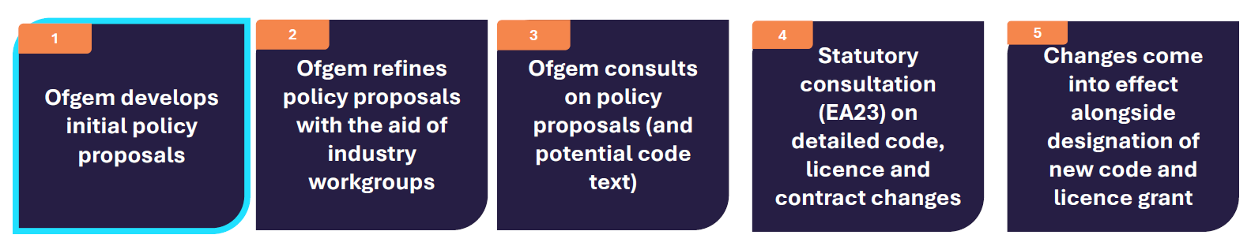
Ofgem Spring Update:
  The Ofgem Energy Code Reform (ECR) Webinar took place on Thursday 23rd April, and provided some insight into Phase 2 of ECR. To reiterate, Phase 2 is where the UNC and IGT UNC are to be consolidated into the UGNC.
  Ofgem intends to lead the initial consolidation phase, which will be limited in scope. The primary aim will be to create a common contractual framework for each code and to rationalise relevant governance processes.
  The new Code manager will then lead the longer-term rationalisation and simplification of the consolidation codes once the licence has been granted.

Slide 5
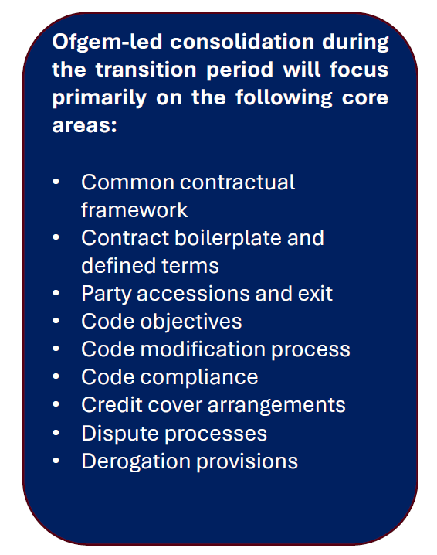
How does RG008 play into this?
RG008 could review the bullet points taken from Ofgem's Spring Update to further assist their code consolidation work.
This would be done, as we are doing with Phase 1 of the works, reviewing the IGT UNC against the UNC to capture any differences, if there are any. Below, I have pointed to the Parts of the IGT UNC that talk to the topics listed:
Part A – Introduction and Interpretation
Open to people's thoughts, but I would suggest that we look to tick off these Parts of the IGT UNC as first points of call, now that we have completed Part C in its entirety.
This would be a move away from doing the ‘quick’ and ‘easy’ Parts of the IGT UNC (i.e. the short parts!), but of course, we will return to these as the review progresses.
Part M – Definitions
Part K – General / Part CI – Supply Point Administration
Gas Transporter Licence, Condition 9 / Part L – Modification Rules
Part L – Modification Rules
Part K – General
Part G – Pipeline Transportation Charges, Invoicing, Payment and Code Credit
Part K – General
Part O – Derogation Rules

Slide 6
Questions?

Slide 7
Contact Details:
Jenny Rawlinson (Industry Change Manager):
jenny.rawlinson@buuk.co.uk
Aleksis Butler (Regulatory Analyst):
aleksis.butler@buuk.co.uk
Code Administrator (Talan):
IGTUNC@talan.com
RG008 - IGT UNC Code Review in preparation for Code Manager and Code Consolidation

