Slide 1
IGT UNC RG008: Preparation for Code Manager and Code Consolidation
Thursday 12th March 2026

Slide 2
Contents:
Overview of Review Intent
What is a “nuance”?
Individual Network Codes
Questions
Contact Details

Slide 3
Overview of Review Intent:
As established this Review looks to commence IGT UNC preparatory activity ahead of the Code Manager appointment and the subsequent Code Consolidation work that will be undertaken as part of Code Reform and the introduction of the Unified Gas Network Code (UGNC). The scope covers the main IGT UNC document, Ancillary, Guidance and Process documents, with work being split into two phases:
  Phase 1:
  Identify IGT UNC nuances to those of the UNC. For example, Metering, New Connections process, invoicing; and
  Phase 2:
  Correcting errors (i.e. housekeeping changes) and ensuring that the governance works where it refers to the UNC. This would look to explore whether the direct referencing of the UNC within the IGT UNC still works and is aligned.
We are not needing to undertake this work, but it will put parties of the IGT UNC in a good position to be able to compare existing legal provisions, with those that will be placed into the UGNC. Furthermore, we can provide the Code Manager and those creating the legal text a record of the work we have completed to help inform their work.

Slide 4
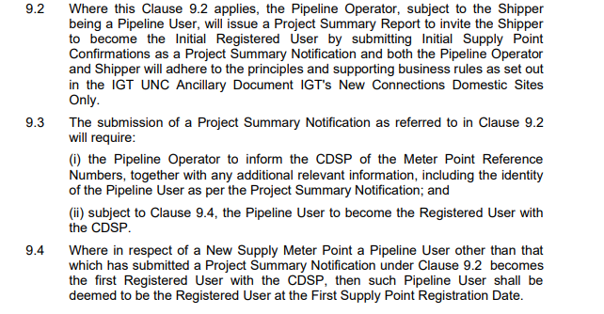
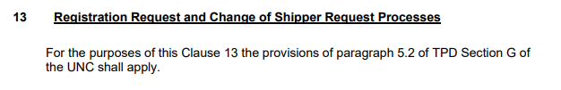
What is a “nuance”?
  There was a short debate as to what qualified as a “nuance”, and whether it should be called something entirely different. Below is what we considered an IGT UNC “nuance”, and what is not a “nuance”:
  What qualified this as a “nuance”, is that it is unique to the IGT UNC. In aid of making things easier for current and future workgroup participants, we could start referring to these as unique parts of the IGT UNC. Thus, moving away from the term “nuance”.
  As a reminder, we would see that we log these unique parts so that, when a full legal review is undertaken, we will more easily be able to reconcile that they have been captured.

Slide 5
Individual Network Codes
  For those in attendance of the Review Group that took place on Thursday 12th February 2026, there was a brief discussion on Individual Network Codes, and whether each IGTs network code would be reviewed as part of RG008. We have since reviewed our network codes in consideration of the incoming Gas Contract Manager, and the new Unified Gas Network Code (UGNC).
  There is potential that Ofgem will remove the licence obligation on GDNs to deliver the UNC as part of the UGNC. At this point they maybe consideration to removing the obligation/ability on Transporters to have their own INCs. As per the Gas Transporter Licence: Standard Conditions, Condition 9: Network Code and Uniform Network Code, Paragraphs 2 to 4, there is a requirement for the licensee to prepare a network code.
  We would recommend parties to review their INCs, and to consider impacts of having them removed. If this were to happen, it would be good, as a constituency, to be prepared for this as a potential outcome.

Slide 6
Questions?

Slide 7
Contact Details:
Jenny Rawlinson (Industry Change Manager):
jenny.rawlinson@buuk.co.uk
Aleksis Butler (Regulatory Analyst):
aleksis.butler@buuk.co.uk
Code Administrator (Talan):
IGTUNC@talan.com
RG008 - IGT UNC Code Review in preparation for Code Manager and Code Consolidation

