Slide 1
CSL01: Exclusion of Standalone Networks from IGT UNC
February 2026
Harry Davis
CNG Services Ltd
harry.davis@cngservices.co.uk www.cngservices.co.uk

Slide 2
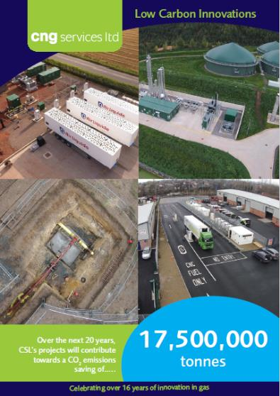




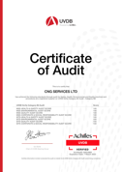

CNG Services Ltd
CNG Services Limited (CSL) provides consultancy, design and build services to the biomethane industry, all focused on reducing Greenhouse Gas (GHG) emissions
In the past 10 years our efforts have produced a material impact with an estimated 20 year project life reduction in CO2 emissions of 17,500,000 tonnes through:
  Biomethane injection into the gas grid
  Running trucks on Bio-CNG
  Acting as developer and design and build contractor for the Highlands CNG Project
Working on a number of Biomethane, H2 and CCUS innovation projects including:
  Biomethane from manure with CCS
  Biomethane direct into the NTS
  Green H2 into the NTS and Hydrogen Business Model Projects
  Reverse Compression to Create Capacity for Biomethane Injection
CSL is an ISO 9001, 14001 and 45001 approved company and has also achieved Achilles certification. CSL is GIRS accredited for design and project management and has been certified as a competent design organisation for high pressure UK onshore natural gas works by DNVGL

Slide 3
Standalone IGT Network
Green Gas Consumption
Green Gas Production
GGSS Point
AD Plant
Biogas Upgrading Unit
GQS
Entry Meter
IGT Network
Exit Energy Measurement
I&C Consumer
Reject
To Flare
IGT pipeline transports gas directly from AD Plant to Consumer
No gas supply from any other network
GT Licence requires transportation arrangements to be in accordance with Network Code
UNC specifies arrangements for existing standalone GDN networks – Statutory Independent Undertakings
IGT UNC is silent on standalone IGT Networks

Slide 4
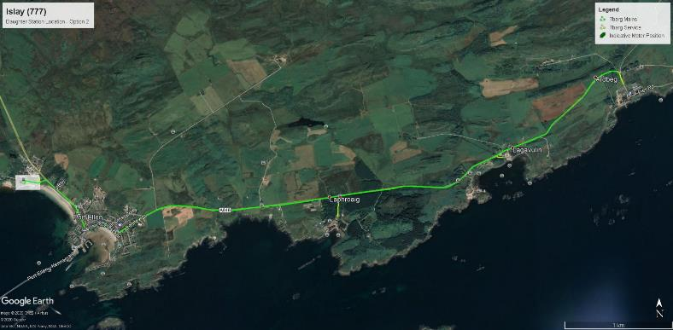
Potential Standalone Network on Islay:
Decarbonising Whisky Distilleries
The identified route is predominantly along the public highway
Initially one, potentially two AD plants utilising distillery waste
Four distilleries, but also potential for others to be connected
No domestic connections
A small kiosk to be installed complete with Pressure Reduction and Metering.
Each service pipe will terminate with an emergency control valve and a 7 bar to [200] mbar pressure reduction unit
AD plant 2
Pipe Route
Ardbeg
Port Ellen
Lagavulin
AD plant 1
Laphroaig

Slide 5
Practical Issues
AD plants have automatic flaring if pressures build beyond a set point
Injection must be no more than demand to avoid flaring
    Identified cases have higher demand than potential supply, reducing rather than eliminating alternative fuels (e.g. oil usage on Islay)
  Storage is not economic
Existing standards to be applied
    GSMR for gas quality
    Entry standards the same as NGT (i.e. Murrow and Glentham)
  Code Issues
  Supply Point Code presumptions do not apply
    Cannot offer firm supply – aim is firm demand rather than firm supply, contrary to Code presumption
    “Rationing” rules required
  Managing Imbalances
Supporting competition
Code applies by default, but does not deal with the specific circumstances

Slide 6
Supply Point Code presumptions do not apply
Code is predicated on supply being firm
Interruptible rules for demand reduction
Standalone network requires demand to be above supply
The gas has nowhere else to go, supply is inflexible (bar flaring)
“Rationing” rules required with multiple offtakes
  On Islay, how to ensure each distillery receives a fair share of the available gas
Adding rules for every possibility would be a disproportionate amount of Code drafting, potentially for situations that will never arise in practice
Bespoke, location and customer specific, rules appropriate

Slide 7
Managing Imbalances
Standalone network must always balance physically
Small commercial imbalances are inevitable
    Two meters will always give slightly different readings
    Minor time of flight issue and potential pressure changes
Can be managed within location specific standalone network rules
    If one entry point and one exit point, a single meter could be used
    With multiple entry or exit, could scale allocated demand to equal supply
Objective is no commercial “leakage” from standalone network
No impact on Code processes or costs

Slide 8
Supporting Competition
Shippers/Suppliers required as per Gas Act
  Location specific rules will allow project developers to choose their own Shipper/Supplier
Pipelines will be high pressure to identified large consumers
    No domestic consumers
  Small number of consumers anticipated
  Proposal is that , since outside Code, IGT maintain necessary records rather than being within central systems

Slide 9
Proposed Implementation Route
Would to be difficult to develop rules within the UNC that accommodate simple processes for all standalone IGT networks
Standard IGT Network Code says that IGT UNC rules apply except if stated otherwise
CSL propose modifying our Network Code to exclude standalone networks from the IGT UNC and hence UNC
Standalone Network defined as one with no Connected System Exit Point
  Proposed modification subject to Ofgem approval
CSL01 proposes that any network without a Connected System Exit Point is excluded from the Code

Slide 10
Proposed Legal Text
For any standalone network (Pipeline(s) that are not associated with a Connected System Exit Point, as defined in the Uniform Network Code, since they are not supplied with gas via an IGT Pipeline nor GT Network), the whole of the IGT UNC is to be disapplied. For the avoidance of doubt, all statutory obligations will apply to these networks and the arrangements put in place for each standalone network will necessarily reflect this.

