Slide 1
IGT179: NExA Tables Update and Related Documents

Slide 2
Purpose of the Modification:
This Modification looks to provide an update to the NExA tables, and some of the language used around the AQ Review process to provide greater clarity. This will be achieved by adding relevant dates to the NExA tables to provide time periods for which they are relevant, with further clarity added for when the document is ‘live’ or ‘proposed’.

Slide 3
Context:
When undertaking an internal review of the NExA tables that had been shared for implementation in 2026, it became apparent that the table labelled ‘Current NExA AQ Values’ were incorrect and were in fact the values from the May 2022 review, for implementation for February 2023.
This led to a discussion with the Independent Networks Association (INA), and the IGT UNC Code Administrator to find a solution to address this issue. A clear and obvious solution appeared as providing clear dates on the documentation as to when the values are valid to and from. This will provide the necessary clarity and hopefully prevent incidences like this happening again.
It should be noted that, despite the ‘Current NExA AQ Values’ being incorrect, the table titled ‘Review Values All IGTs’ has been consistently correct, thus meaning that there have been no erroneous AQ Values implemented because of this error.

Slide 4
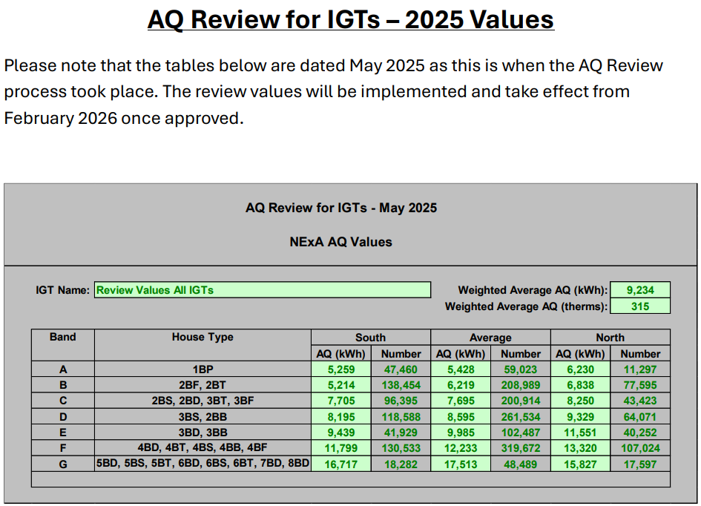

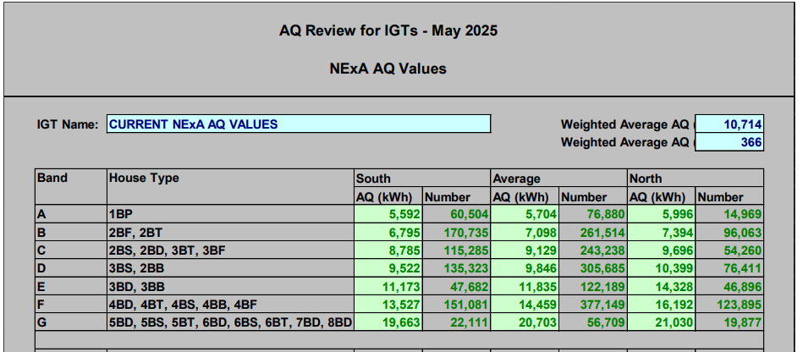

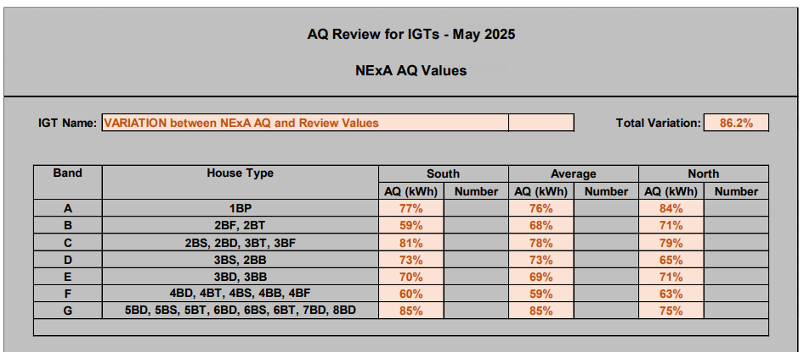
Evidence:
The tables to the left of the slide are from the AQ Review exercise that was undertaken this year and shared with parties of the IGT UNC.
The table labelled ‘Current NExA AQ Values’, is incorrect – it does not show the values that are currently in place as implemented last year.
This has a knock-on effect with the variation table, as the variance is done with incorrect ‘current’ values, and the new collation values for next year.

Slide 5
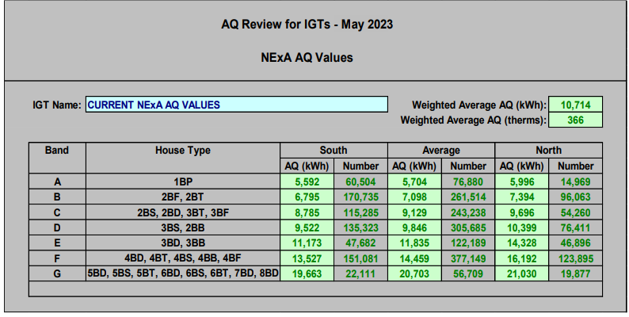
Where did it start?
The ‘Current’ NExA AQ Values were accurate for the AQ Review exercise that took place in May 2023.
The values shown to the left were the ‘current’ values for the time – having been collated in May 2022.
However, they had not been updated since then due to a work process error.

Slide 6
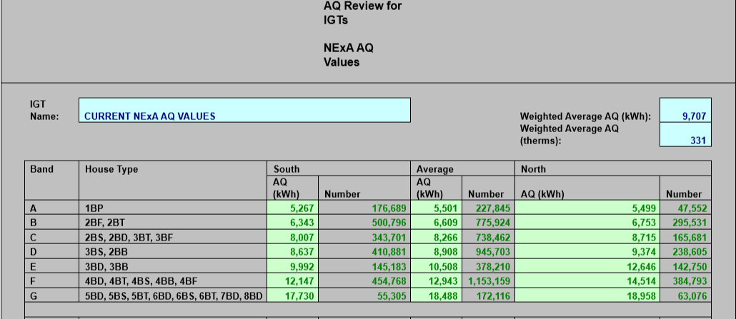
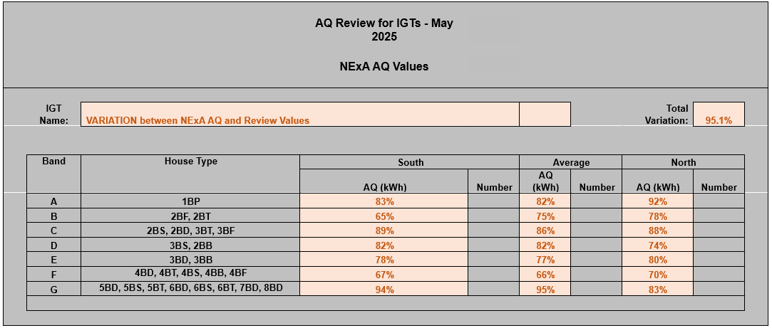
How should it have looked?
The tables on the left have been updated to reflect the correct values.
The top table – the collation of all IGT AQ Values – has been consistently correct. No changes made.
The middle table – the ‘current’ NExA AQ values – has been updated to show the collation figures agreed last year.
The bottom table – the variation – shows what the variation would be now: 4.9%.
  In comparison the incorrect table shown earlier would indicate a 13.8% variance.

Slide 7
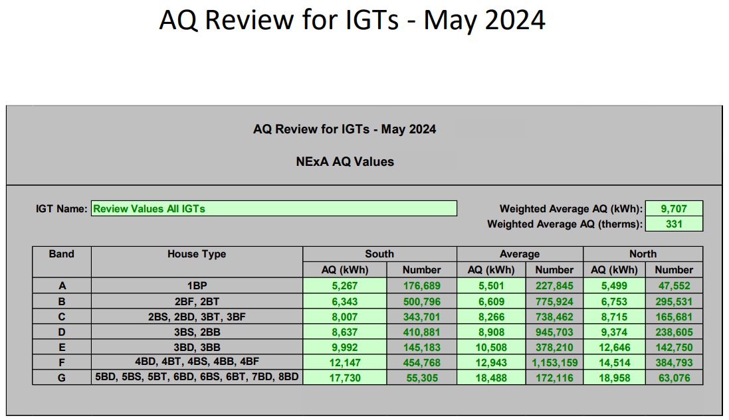
Where have the correct values come from?
The correct ‘current’ values can be found from last years (2024) AQ Review exercise – shown to the left.
The variation was done using the existing template available on the IGT CSEP NExA Table Procedures Document using the actual ‘current’ values against the new collated values.
The next slides will detail how we can make the tables clearer.

Slide 8
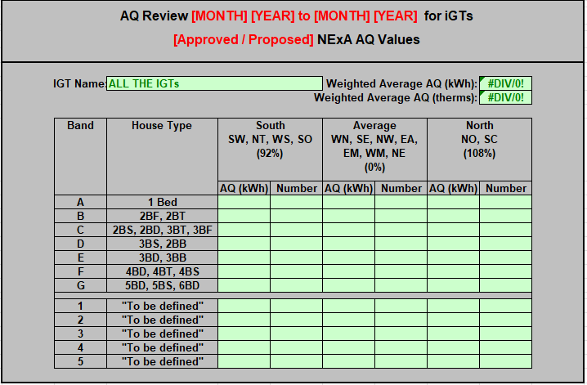
Suggested Solution: NExA Table
Providing more clarity as to the dates the NExA AQ Values are valid from, and whether they have been approved or are just proposed will be beneficial.
An indicative table to the left of this text provides a visual of what this could look like.
The text in red are the new suggested additions to the NExA AQ table.

Slide 9
Suggested Solution: Legal Text
The Modification would require some amendments to be made to the IGT CSEP NExA Table Procedures Document.
The suggested legal text can be found on the Modification Webpage.
In summary, the legal text looks to update the link to the NExA Table template, as well include the new tables, with explanations for each respective table.

Slide 10
End of IGT179 Scope:
Text from here on are just other considerations and further thoughts on how we could potentially improve documentation of the AQ Review Process.
This is not part of the Modification and thus not in the scope of what is being proposed.

Slide 11
Further Thoughts: IGT UNC Website – AQ Review Process
Suggest simplifying the language and webpage on the IGT UNC website regarding the
AQ Review Process would be renamed to “Annual AQ Review Exercise”, with the relevant documents being accessed via the tab to be simplified to “[2025] AQ Review Exercise”.
This will help distinguish the live document from reference documents.
A mock up of this has been created and can be seen on the next slide against the existing version.

Slide 12
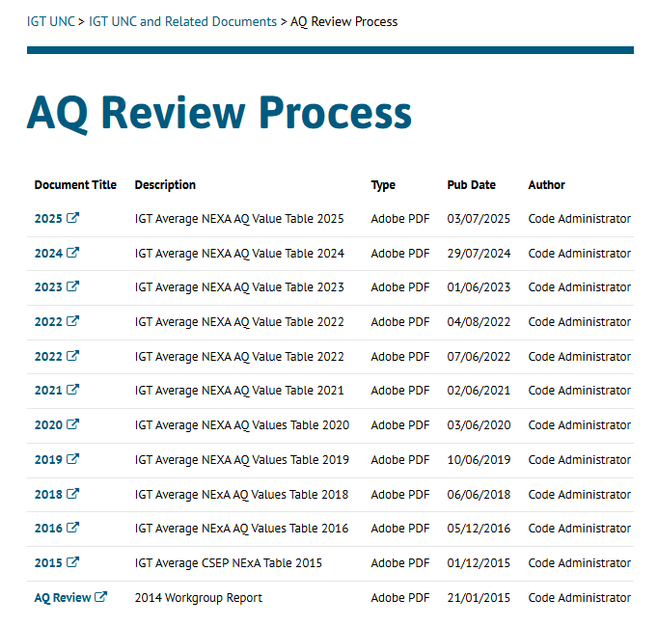
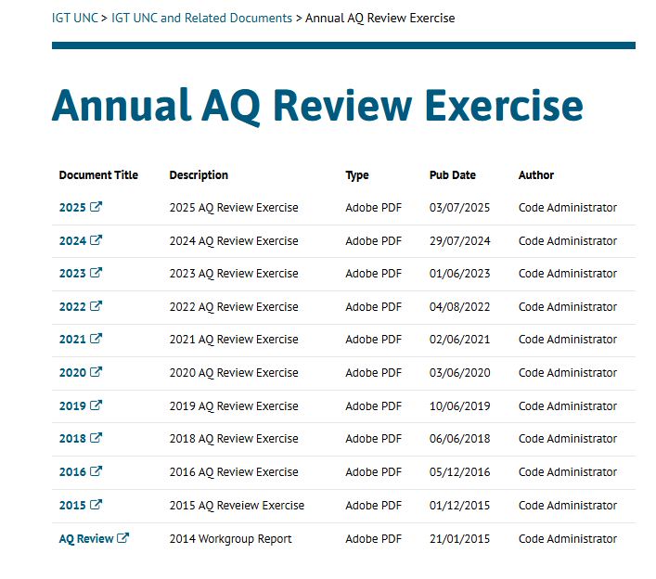
Further Thoughts: IGT UNC Website – AQ Review Process
Current Page:
Suggested Page:

Slide 13
Further Thoughts: Templates
The template that is being amended is in the IGT CSEP NExA Table Procedures Document. Templates for Modifications, are all located in one place on the IGT UNC website providing easy and simple access.
We would suggest that templates for IGT UNC should be located in a singular location, for the greatest ease of access. They do not need to be removed from where they currently reside, as this may cause unnecessary confusion.

Slide 14
Contact Information:
Code Administrator: IGTUNC@talan.com
Proposer: aleksis.butler@bu-uk.co.uk

